Slide 1
Java 3 Team Project Presentation - Project Management System
Jing Wang/Jie Zhu
March 7, 2018

Slide 2
Agenda
Background
Solution Overview
Challenges and Solutions
What we learned
Future work
Summary

Slide 3
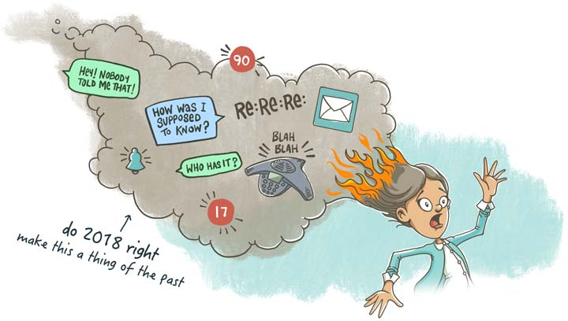
Background
Purpose
- Project management
- Risk control
Solved problems
- Security
- Customization

Slide 4
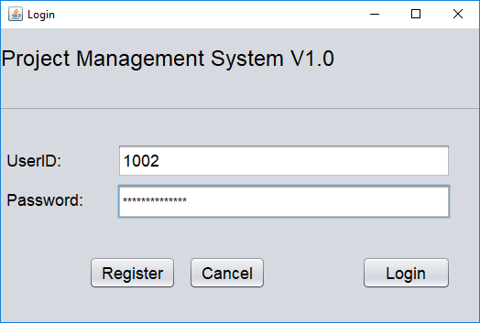
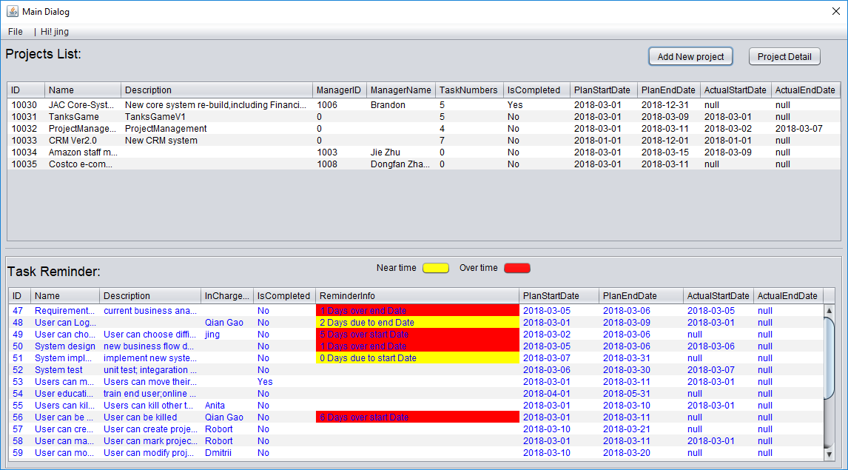
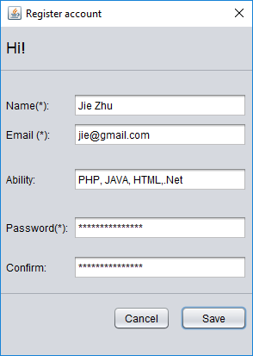
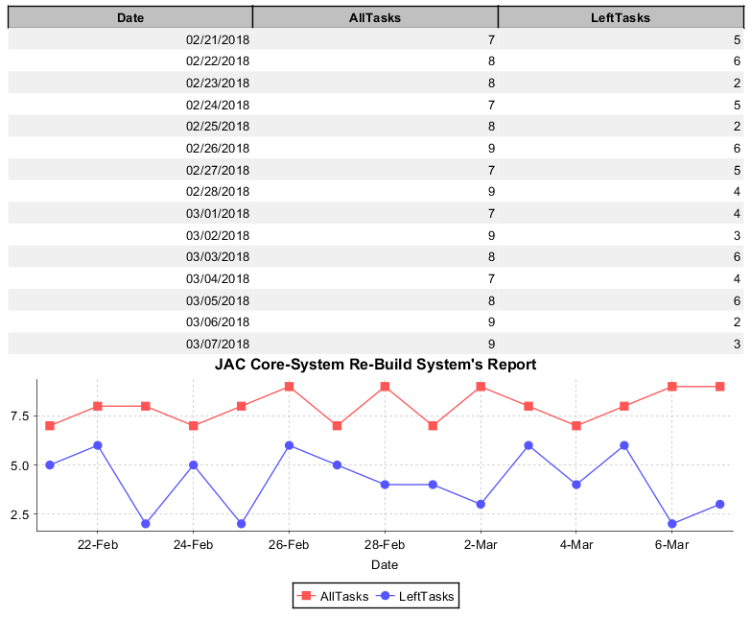
Solution Overview 1/2

Slide 5
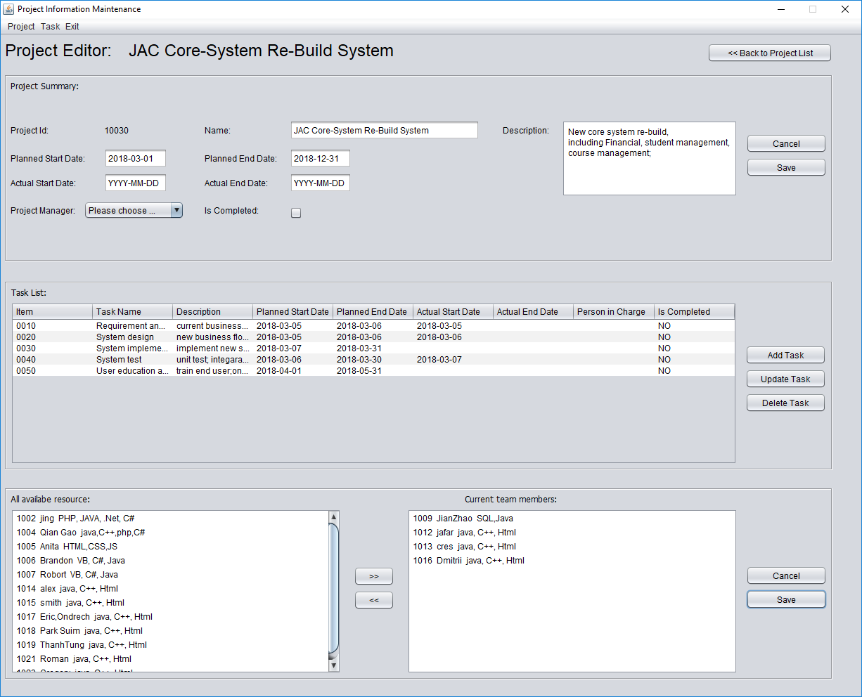
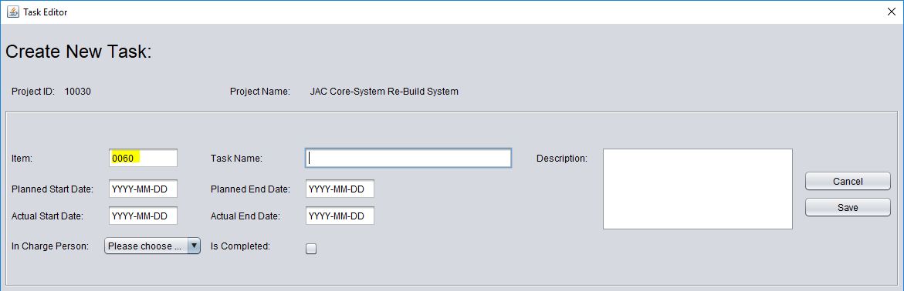
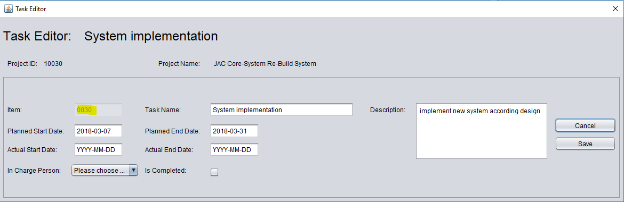
Solution Overview 2/2

Slide 6
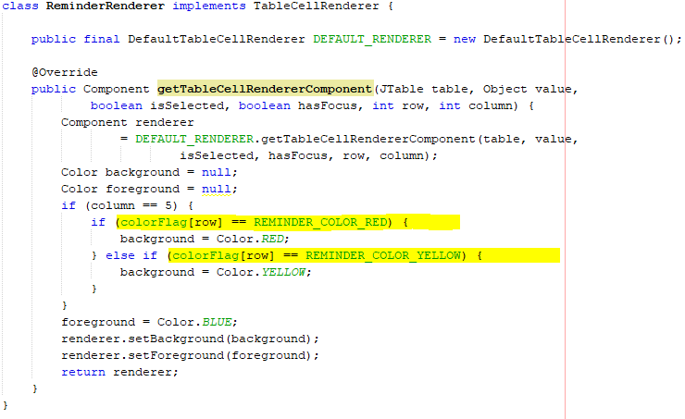
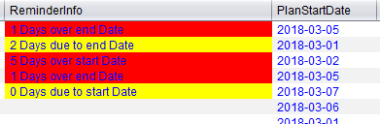
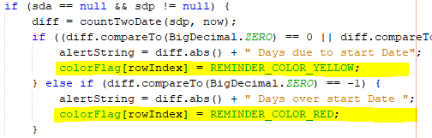
Challenges and Solutions 1/3
JTable operation
- Cell color setting

Slide 7

Challenges and Solutions 2/3
JTable operation
- Table sorting
- Table refreshing

Slide 8
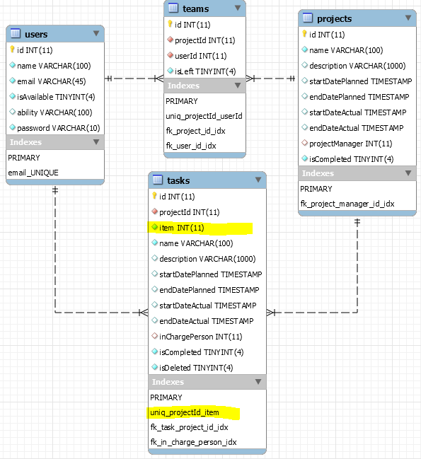
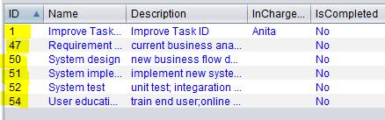
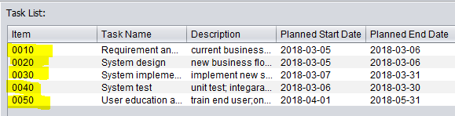
Challenges and Solutions 3/3
Task id in the task list
- Before change
After change
The way Generating new task item no.

Slide 9

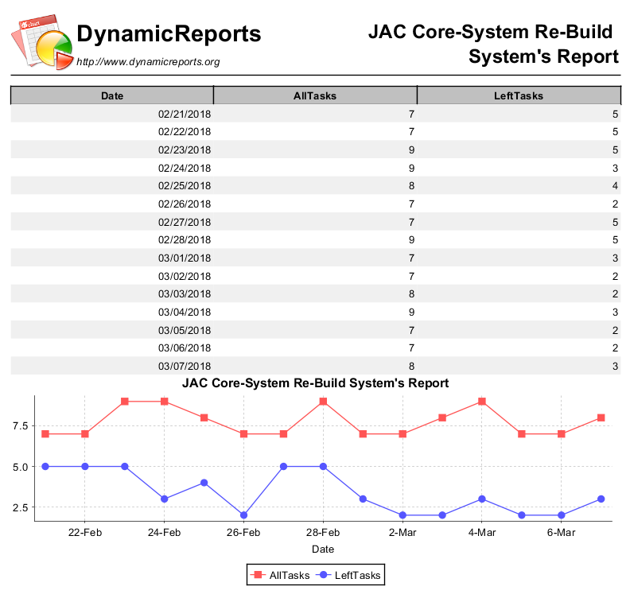
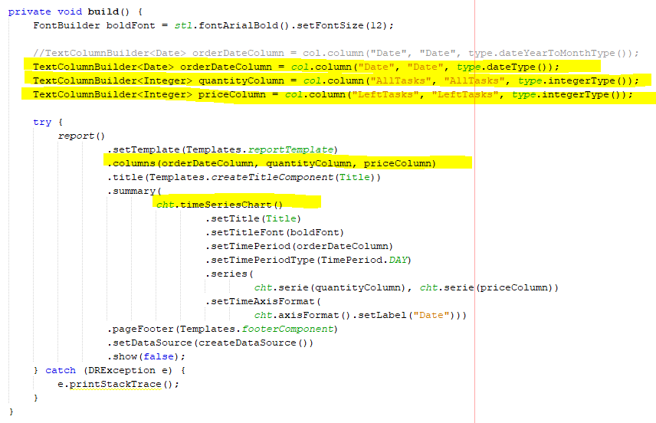
What we learned 1/2
Dynamic report

Slide 10

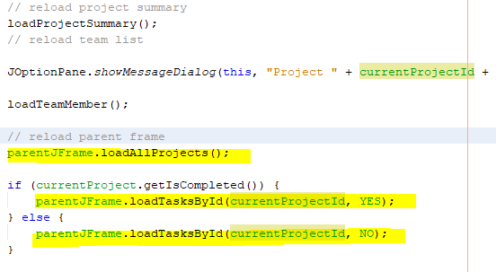
What we learned 2/2
Interchange between multiple forms
Parent Form
Child Form

Slide 11
Future work
Add more functions
- Email reminder
- Permission management
- Create project and task by coping one existing one
- Improve reports
Develop Web version

Slide 12
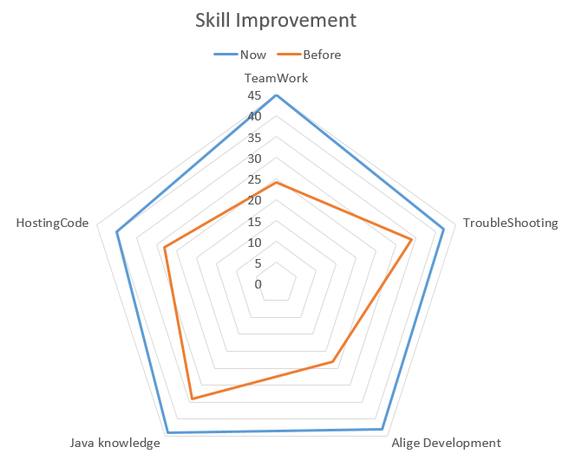
Summary
Delivered a complete system
Learned new technologies (JTable, third-part Libraries)
Collaborating with team
Hosting code on Github/Bitbucket
Applied Agile development model

